Slide 1
CS312 Artificial Intelligence
Lecture # 09
HITEC University, Taxila
Mr. Mubashir Iqbal
Fall-2025

Slide 2
Lecture Content
Introduction to Datasets and Online Platforms:
Introduction to dataset,
Searching and Downloading datasets from different online platforms
Preprocessing
Exploratory Data Analysis (EDA)
Data Visualization

Slide 3
Dataset

Slide 4
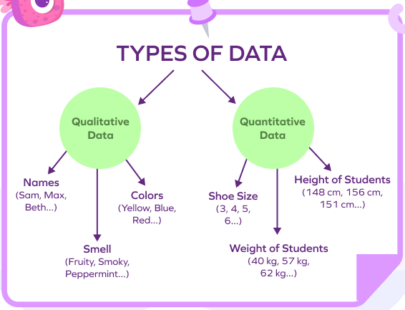
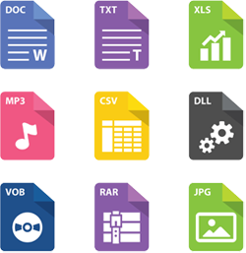
What is Data, and File?
Data: Raw facts or figures without context, which are collected and processed to provide meaningful information. Data can be in many forms, such as text, numbers, images, audio, or video.
File: A collection of related data stored together on a computer system, typically organized in a specific structure or format. Files can be text documents, images, videos, spreadsheets, etc.

Slide 5
Properties of data by Structure
1. Structured Data: Data that is organized in a clear, fixed format, typically in tables with rows and columns (like a spreadsheet)
An Excel sheet with columns for “Name”, “Age” and “Salary” is structured data, as each column has a specific type and format
2. Unstructured Data: Data that does not have a specific format, making it harder to store in a structured database.
Text documents, emails, images, videos, and social media posts are unstructured

Slide 6
Properties of data by Structure
3. Semi-Structured Data: Data that isn’t as organized as structured data but has some tags or markers that make it easier to categorize
JSON or XML files are semi-structured, as they use tags (like <name>John</name>) to give some structure to the data, even though it’s not in a table format.

Slide 7
Properties of data by Type
1. Quantitative Data (Numerical Data): Data that can be measured and expressed as numbers
The height of students in centimeters (like 150 cm, 160 cm) or the number of items sold (like 30, 50)
i. Discrete Data: Numeric data with specific, countable values.
Number of children in a family (1, 2, 3, …)
ii. Continuous Data: Numeric data that can take any value within a range.
Temperature (20.5°C, 22.7°C) or height (170.2 cm, 172.5 cm)

Slide 8
Properties of data by Type
Categorical Data (Qualitative Data): Data representing categories or groups rather than numerical values.
Colours of cars (like "red," "blue," "black") or types of products in a store (like "electronics," "furniture").
i. Nominal Data: Data without any order.
Types of pets (dog, cat, bird)
ii. Ordinal Data: Data with an order but without specific numeric differences.
Rating levels (poor, fair, good, excellent)

Slide 9
What is Datafication?
The datafication term was introduced in 2013.
A process of “Taking all aspects of life and turning them into Data” is called datafication.
This includes converting actions, emotions, and interactions into data points.
Examples:
Want to purchase a product or use a service (Rating)
Want to download a mobile app - (Reviews)
Want to Watch a movie on YouTube (Watch time/Likes, Comments)
Social media posts

Slide 10
Dataset
A dataset is a structured set of data values arranged in rows and columns (similar to a table or spreadsheet). Each row represents a record (observation), and each column represents a feature (attribute) describing that record.
Here:
Each row = one person (sample)
Columns = features (Age, Salary) + target label (Purchased)
Age | Salary | Purchased
25 | 40,000 | Yes
32 | 52,000 | No

Slide 11
Components of a Dataset
A dataset used in AI/ML typically contains:
a) Instances / Samples / Observations: These are the individual entries (rows). Example: 1,000 patients in a medical dataset → 1,000 instances.
b) Features / Attributes / Variables
These are the inputs used for learning. Examples:
Height, weight, blood pressure
Sensor readings
Pixels of an image
Words in a sentence
Features may be:
Numerical (age, salary)
Categorical (gender, city)
Boolean (True/False)
Textual (sentence, paragraph)
Multimedia (images, audio)

Slide 12
Components of a Dataset
c) Target Variable (Label)
Used only in supervised learning. This is the output the model tries to predict.
Examples:
Disease = Yes/No
Price of a house
Sentiment = Positive/Negative
Image class = Cat/Dog
d) Metadata
Information describing the dataset:
Column names
Source of data
Units (kg, cm, USD)
Collection method
Metadata is essential for interpreting data correctly.

Slide 13
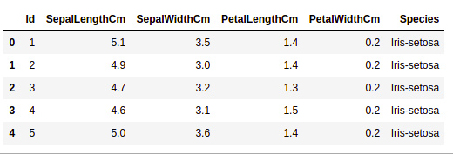
Types of Datasets in AI
Datasets differ based on the learning task:
a) Structured Dataset
Tabular data (rows + columns). Examples: CSV files, Excel sheets.
b) Unstructured Dataset
No fixed structure. Examples:
Images
Videos
Audio
Free-form text
c) Semi-Structured Dataset
Partially organized formats. Examples:
JSON
XML
Log files

Slide 14
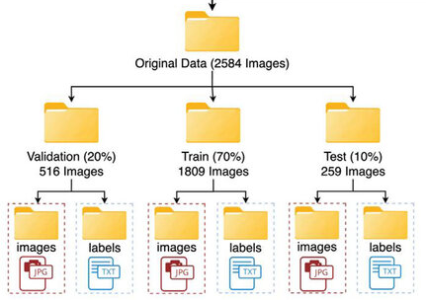
Dataset Formats Used in AI
Different file types store datasets:
CSV (most common in ML)
Excel files (.xlsx)
JSON
Image files (PNG, JPG)
Audio (WAV, MP3)
Video (MP4)
Database tables (SQL)

Slide 15
Sources of Datasets
Datasets are collected from various sources:
Sensors (IoT devices, drones, medical sensors)
Web scraping
Surveys and experiments
Government/open data portals
Business systems (ERP, CRM, sales records)
Online platforms (Kaggle, UCI, GitHub)

Slide 16
Online platforms (Kaggle, UCI, GitHub)
Finding Datasets for Project
Kaggle: Your Home for Data Science
UCI Machine Learning Repository
Data.gov Home - Data.gov
World Bank Open Data | Data
GitHub: awesomedata/awesome-public-datasets: A topic-centric list of HQ open datasets.
OpenML
DataHub

Slide 17
List of small Datasets for start
Iris Dataset
Classifies flowers into three species based on sepal and petal dimensions.
Link: iris.csv
Zoo Dataset
Classifies animals based on features like fur, feathers, and aquatic.
Link: Zoo - UCI Machine Learning Repository
Titanic Dataset
Predicts survival on the Titanic based on passenger details like age, sex, and class.
Link: datasets/titanic.csv at master · datasciencedojo/datasets

Slide 18
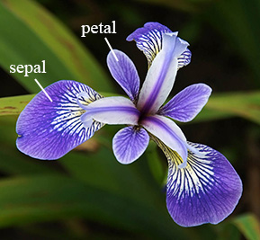
What is Iris Dataset?
The Iris dataset was introduced by Ronald Fisher in 1936.
Dataset contains 150 records/samples.
The dataset is used to classify different species of the Iris flower based on their physical measurements.
Features:
Sepal length (in cm)
Sepal width (in cm)
Petal length (in cm)
Petal width (in cm)

Slide 19
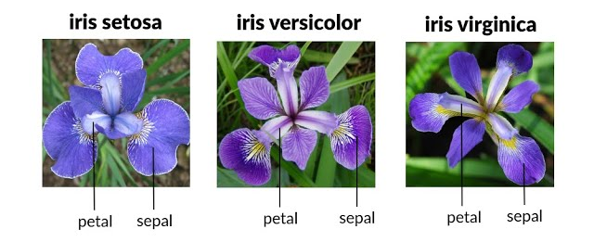
Example (Iris Dataset)
Target Variable: The species of the flower, which can be one of three classes:
Iris Setosa (0)
Iris Versicolor (1)
Iris Virginica (2)

Slide 20
Example (Iris Dataset)
sepal.length | sepal.width | petal.length | petal.width | variety
5.1 | 3.5 | 1.4 | 0.2 | Setosa
4.9 | 3 | 1.4 | 0.2 | Setosa
4.7 | 3.2 | 1.3 | 0.2 | Setosa
4.6 | 3.1 | 1.5 | 0.2 | Setosa
7 | 3.2 | 4.7 | 1.4 | Versicolor
6.4 | 3.2 | 4.5 | 1.5 | Versicolor
6.9 | 3.1 | 4.9 | 1.5 | Versicolor
6.5 | 3 | 5.8 | 2.2 | Virginica
7.6 | 3 | 6.6 | 2.1 | Virginica
4.9 | 2.5 | 4.5 | 1.7 | Virginica

Slide 21
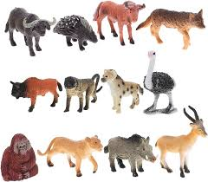
What is Zoo Dataset?
The ZOO dataset contains 59 records/samples and 16 features. There are 7 target classes in it and all the data is in discrete form.
List of Features
Hair | Feathers | Eggs
Milk | Airborne | Aquatic
Predator | Toothed | Backbone
Breathes | Venomous | Fins
Legs | Tail | Domestic
Catsize

Slide 22
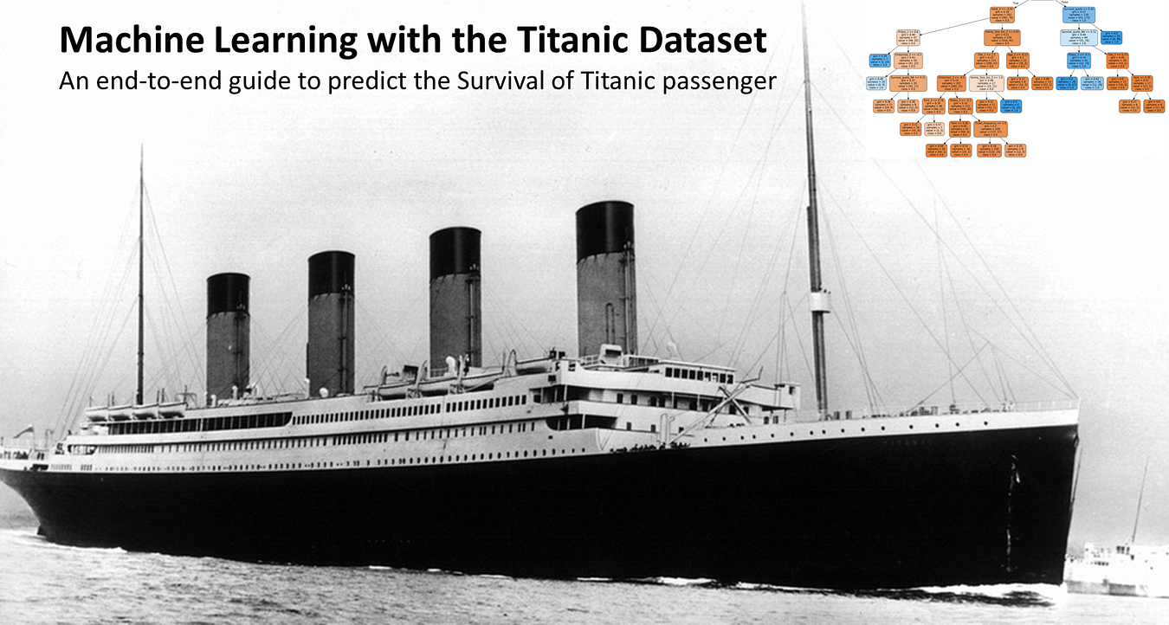
What is Titanic Dataset?
The Titanic dataset contains 891 records/samples and 11 features. It is the binary classification (Survived or Not-Survived). The dataset needs the label-encoding because some features are in categorical form.
List of Features
Passenger ID | Survived | Pclass
Name | Sex | Age
SibSp | Parch | Ticket
Fare | Cabin | Embarked

Slide 23
Population & Sample
Population: The word population immediately makes us think of the entire Pakistan population of 250 million people or the entire world’s population of 7 billion people. In statistical inference population isn’t used to simply describe only people. It could be any set of objects or units, such as tweets or photographs, or stars. It is denoted with N.
Sample: A sample, is a subset of the units of size ƞ in order to examine the observations to draw conclusions and make inferences about the population. There are different ways of sampling and we should be aware of particular sampling mechanisms because it can introduce biases into the data. If the subset is not a representative version of the population then, any conclusions you draw will simply be wrong and one-sided.

Slide 24
How much Data Required
“How much data we need depends on what our goal is”
For analysis purposes, we don’t need to store all the data all the time (sampling is a solution).
Alternatively, for serving purposes if we have to generate the correct information about a user, then we need to have all the information for that particular user.
Bias in the data: Even if we have access to all of Facebook’s, Google’s, or Twitter’s dataset, any analysis we make from that data should not be extended to conclude humans beyond those sets of users, or even those users for any particular day.

Slide 25

Pandas Library (Python)

Slide 26
Pandas Library (Python)
Pandas is an open-source Python library widely used for data analysis and manipulation. It provides powerful and flexible data structures, primarily Series and DataFrames, designed to make working with labeled or relational data intuitive and efficient.
Key Features and Capabilities:
Data Structures:
Series: A one-dimensional labeled array capable of holding any data type (integers, strings, floats, Python objects, etc.). It can be thought of as a single column in a spreadsheet.
DataFrame: A two-dimensional labeled data structure with columns of potentially different types, similar to a spreadsheet, SQL table, or a dictionary of Series objects. It is the most commonly used Pandas object.
Data Handling: Pandas allows for importing data from various sources (CSV, Excel, SQL databases, JSON, etc.) and exporting data to these formats.

Slide 27
Pandas Library (Python)
Data Manipulation: It offers extensive functionalities for:
Cleaning: Handling missing data, removing duplicates, and correcting inconsistencies.
Transformation: Reshaping, pivoting, merging, and joining DataFrames.
Analysis: Grouping data, applying functions, and performing calculations like sums, averages, and counts.
Indexing and Selection: Efficiently accessing and filtering data based on labels or conditions.
Installation:
Pandas can be installed using pip or conda:
pip install pandas

Slide 28
Preprocessing & EDA

Slide 29
Dataset Quality Factors
A high-quality dataset must be:
a) Complete: Few or no missing values.
b) Accurate: Values represent reality.
c) Consistent: Uniform formatting (e.g., date format, units).
d) Balanced: Class distribution is reasonable (e.g., 50% diseased, 50% healthy—not 99% healthy).
e) Relevant: Features must relate to the prediction problem.

Slide 30
Exploratory Data Analysis (EDA)
EDA is a crucial first step in the AI model development process.
It involves examining your dataset to understand its structure, detect patterns, spot anomalies, and generate insights.
EDA typically helps you make decisions about data preprocessing and the types of analysis to apply later on.
import pandas as pd
data = pd.read_csv(r”your_dataset.csv”)

Slide 31
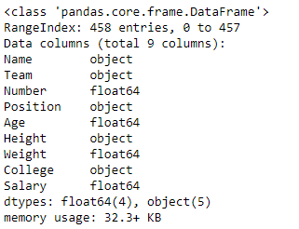
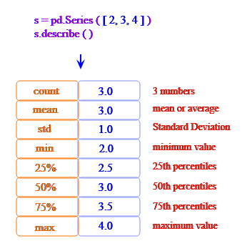
Steps of EDA
1. Understanding Data Structure
print(data.shape)
print(data.head())
print(data.info())
2. Descriptive Statistics
print(data.describe())
print(data['column_name'].value_counts())

Slide 32
Steps of EDA
3. Data Cleaning
i. Handling Missing Values: Identify and handle missing data, either by filling or dropping.
data = data.dropna(inplace=True)
ii. Removing Duplicates: If there are duplicate rows, consider removing them.
data = data.drop_duplicates()

Slide 33
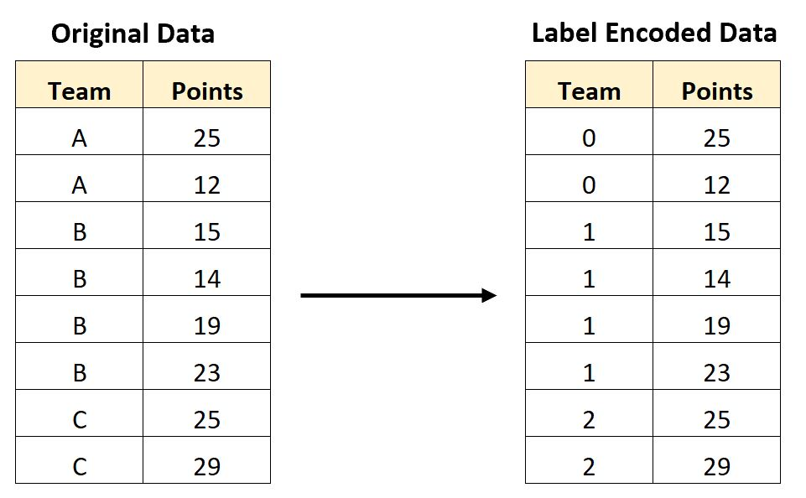
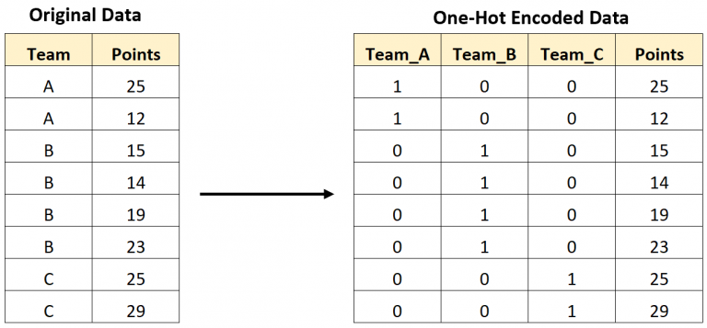
Steps of EDA
4. Encode Categorical Variables
Label Encoding: For ordinal categories, assign a unique integer to each category
One-Hot Encoding: For nominal (non-ordered) categories, create dummy variables (one column per category).

Slide 34
Steps of EDA
5. Data Imbalance
Data imbalance happens when the classes in a dataset are not evenly distributed.
For example:
In medical datasets, most patients might be healthy (90%), and only a few might have a rare disease (10%).
In fraud detection, fraud transactions are far fewer than normal transactions.

Slide 35
Steps of EDA
Why is Data Imbalance Important?
Model behaviour which is trained on imbalanced data:
Bias in Predictions: The model might only predict the majority class and ignore the minority class.
Fairness (Recall, Precision): Models trained on imbalanced data may not provide fair or accurate results for all categories, reducing trust in their predictions.
Real-world Impact: It’s crucial in areas like health care, fraud detection, and fault prediction, where identifying minority classes can be lifesaving or cost-effective.

Slide 36
Steps of EDA
Solutions for Data Imbalance
Resampling Techniques:
Oversampling: Duplicate examples from the minority class
Undersampling: Remove some examples from the majority class
Synthetic Data Generation:
SMOTE (Synthetic Minority Oversampling Technique)
ADAYSN (Adaptive Synthetic Sampling)
Science-Kit Learn library
Algorithmic Solutions:
Use algorithms designed to handle imbalance, like decision trees or ensemble methods

Slide 37
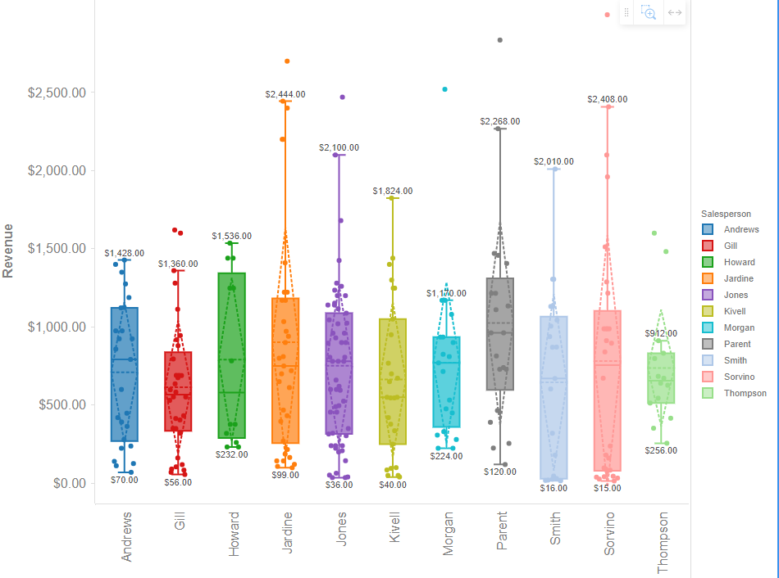
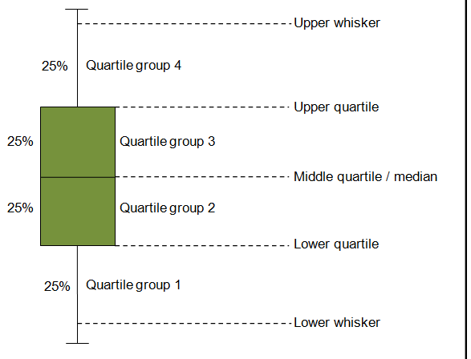
Steps of EDA
6. Identifying Outliers (Box-Plot)

Slide 38
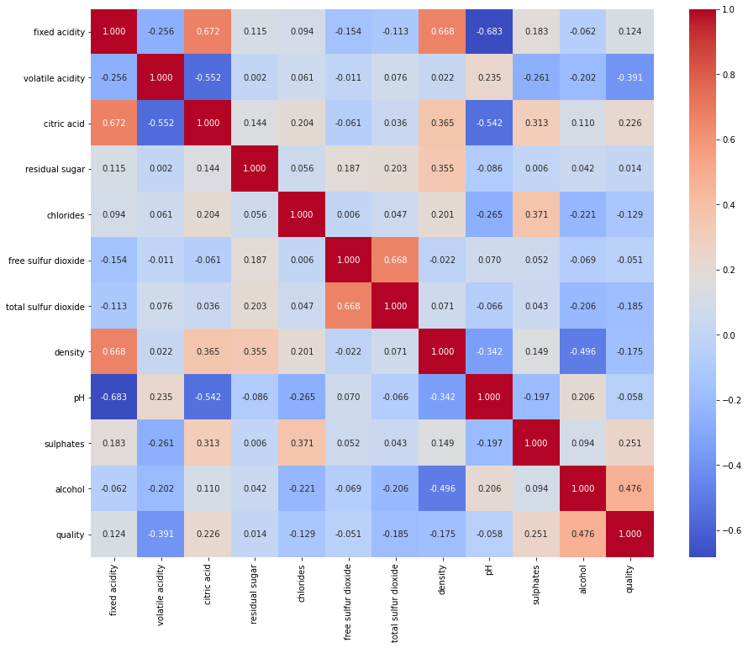
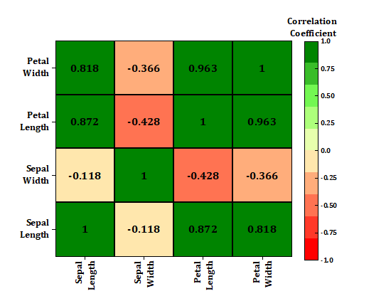
Steps of EDA
7. Heat Map (you already know and draw)

Slide 39
Correlation Analysis
Correlation analysis is a statistical technique.
It is used to evaluate the strength and direction of relationships between two or more variables.
Correlation coefficients, such as Pearson and Spearman, give values about which variables move together.
By analyzing these relationships, we find valuable insights into the data structure, feature dependencies, and potential multi-correlated, which can influence decisions about feature engineering, model selection, and predictive analysis.
Pearson Correlation Coefficient
Spearman Rank Correlation Coefficient

Slide 40
Pearson Correlation Coefficient
Pearson correlation coefficient gives the linear relationship between two continuous variables. The coefficient ranges from -1 to +1.
+1: Perfect positive linear relationship.
-1: Perfect negative linear relationship.
0: No linear relationship.
Pearson is best for normally distributed, continuous data with a linear relationship.
For example, if you have age and blood pressure in a health dataset, a high Pearson coefficient would indicate that they change together linearly.

Slide 41
Example of Pearson Correlation Coefficient
Not Included in your Syllabus
Person ID | Age (X) | Glucose Level (Y)
1 | 43 | 99
2 | 21 | 65
3 | 25 | 79
4 | 42 | 75
5 | 57 | 87
6 | 59 | 81
ID | Age (X) | Glucose Level (Y)
1 | 43 | 99
2 | 21 | 65
3 | 25 | 79
4 | 42 | 75
5 | 57 | 87
6 | 59 | 81
Total | 247 | 486
Mean | 247/6 = 41.16 | 486/6 = 81
Mean (x) = 41.16
Mean (y) = 81.0

Slide 42
Example of Pearson Correlation Coefficient
Not Included in your Syllabus
ID | x | x-X | x-X | y | y-Y | y-Y
1 | 43 | 43 – 41.16 = | 1.84 | 99 | 99 – 81 = | 18
2 | 21 | 21 – 41.16 = | -20.16 | 65 | 65 – 81 = | -16
3 | 25 | 25 – 41.16 = | -16.16 | 79 | 79 – 81 = | -2
4 | 42 | 42 – 41.16 = | 0.84 | 75 | 75 – 81 = | -6
5 | 57 | 57 – 41.16 = | 15.84 | 87 | 87 – 81 = | 6
6 | 59 | 59 – 41.16 = | 17.84 | 81 | 81 – 81 = | 0
Total | 247 |  | 0.04 | 486 |  | 0.0
= (43–41.16)(99–81) + (21–41.16)(65–81) + (25–41.16)(79–81) + (42–41.16)(75–81) + (57–41.16)(87–81) + (59–41.16)(81–81)

Slide 43
Example of Pearson Correlation Coefficient
Not Included in your Syllabus
ID | x | x-X | y | y-Y | (x-X)(y-Y) | (x-X)(y-Y)
1 | 43 | 1.84 | 99 | 18 | (1.84) x (18) | 33.12
2 | 21 | -20.16 | 65 | -16 | (-20.16) x (-16) | 322.56
3 | 25 | -16.16 | 79 | -2 | (-16.16) x (-2) | 32.32
4 | 42 | 0.84 | 75 | -6 | (0.84) x (-6) | -5.04
5 | 57 | 15.84 | 87 | 6 | (15.84) x (6) | 95.04
6 | 59 | 17.84 | 81 | 0 | (17.84) x (0) | 0
Total | 247 | 0.04 | 486 | 0.0 |  | 478.0
= 478.0

Slide 44
Example of Pearson Correlation Coefficient
Not Included in your Syllabus
2. Finding the lower equation
ID | x | x-X | (x-X)2 | y | y-Y | (y-Y)2
1 | 43 | 1.84 | 3.3856 | 99 | 18 | 324
2 | 21 | -20.16 | 406.4256 | 65 | -16 | 256
3 | 25 | -16.16 | 261.1456 | 79 | -2 | 4
4 | 42 | 0.84 | 0.7056 | 75 | -6 | 36
5 | 57 | 15.84 | 250.9056 | 87 | 6 | 36
6 | 59 | 17.84 | 318.2656 | 81 | 0 | 0
Total | 247 | 0.04 | 1240.8336 | 486 | 0.0 | 656

Slide 45
Example of Pearson Correlation Coefficient
Not Included in your Syllabus
Answer = 0.5409

Slide 46
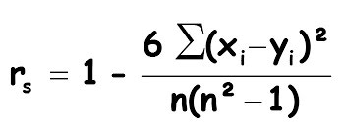
Spearman Rank Correlation Coefficient
Spearman correlation measures the monotonic relationship between two variables. This means it assesses if one variable increases as the other increases, but not necessarily at a constant rate. Spearman’s range is also from -1 to +1
+1: Perfect positive linear relationship.
-1: Perfect negative linear relationship.
0: No linear relationship.
Spearman is useful for non-linearly related or non-normally distributed data.

Slide 47
Data Visualization

Slide 48
Traditional vs. Data-Driven Science
Scientists use different approaches to understand the world. Traditionally, they use a method called hypothesis-driven science, but modern data science also follows a data-driven approach.
1. Traditional Scientific Method (Hypothesis-Driven Science)
This method starts with a theory or assumption about how something works. Then, data is collected to test whether this idea is true or false.
A scientist believes that “drinking more water improves focus”. They collect data from students, analyze it, and see if the hypothesis is correct.
2. Data-Driven Science
Instead of starting with a theory, data-driven science begins by collecting a large dataset. Then, patterns and trends are explored.
These patterns may later become the foundation for new hypotheses.
A company collects customer shopping data and notices that people who buy laptops also buy headphones. This pattern can help businesses make recommendations.

Slide 49
Traditional vs. Data-Driven Science
3. Exploratory Data Analysis (EDA)
Before applying any model or making conclusions, researchers need to explore the data. This process helps in:
✔ Finding patterns and trends.
✔ Detecting missing or incorrect data.
✔ Understanding relationships between different features.
A researcher analyzing health data may find that people who exercise regularly tend to have lower cholesterol levels.

Slide 50
Why is Looking at Data Carefully Important?
Carefully analyzing data helps in many ways:
Identifying Mistakes: Errors in data collection or processing can lead to wrong conclusions.
Checking Statistical Assumptions: Many statistical models rely on specific assumptions. Violations can make models ineffective.
Suggesting New Hypotheses: Patterns in data can inspire new scientific questions.
If an analysis of student scores shows that students who wake up early perform better in exams, this could lead to further research on sleep and learning.

Slide 51
Anscombe’s Quartet

Slide 52
Statistical properties
Numbers alone can sometimes be misleading. Without proper visualization, a person might not fully understand the patterns hidden in data. One famous example that proves this is Anscombe’s Quartet.
Anscombe’s Quartet:
Anscombe’s Quartet consists of four different datasets that have almost the same statistical properties (such as mean, Standard deviation, variance, and correlation).
However, when plotted, they look completely different and tell very different stories.

Slide 53
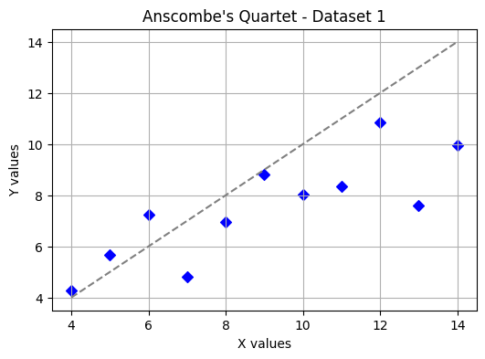
Anscombe’s Quartet
 | X | Y
 | 10.0 | 8.04
 | 8.0 | 6.95
 | 13.0 | 7.58
 | 9.0 | 8.81
 | 11.0 | 8.33
 | 14.0 | 9.96
 | 6.0 | 7.24
 | 4.0 | 4.26
 | 12.0 | 10.84
 | 7.0 | 4.82
 | 5.0 | 5.68
Mean | 9.00 | 7.50
Std | 3.31662 | 2.0304
Correlation | 0.81628
Dataset 1: The data points follow a linear trend, meaning a straight-line relationship exists.

Slide 54
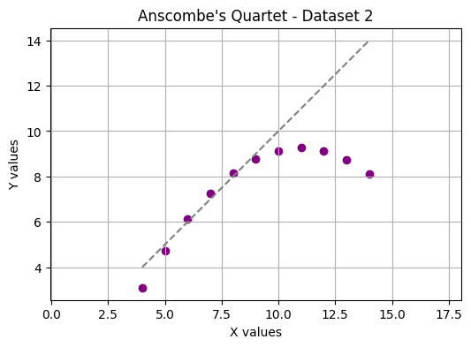
Anscombe’s Quartet
 | X | Y
 | 10.0 | 9.14
 | 8.0 | 8.14
 | 13.0 | 8.74
 | 9.0 | 8.77
 | 11.0 | 9.26
 | 14.0 | 8.10
 | 6.0 | 6.13
 | 4.0 | 3.10
 | 12.0 | 9.13
 | 7.0 | 7.26
 | 5.0 | 4.74
Mean | 9.00 | 7.50
Std | 3.31662 | 2.0304
Correlation | 0.81628
Dataset 2: The points form a parabolic shape, meaning the relationship is not linear.

Slide 55
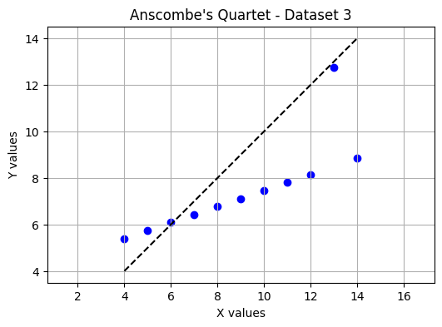
Anscombe’s Quartet
 | X | Y
 | 10.0 | 7.46
 | 8.0 | 6.77
 | 13.0 | 12.74
 | 9.0 | 7.11
 | 11.0 | 7.81
 | 14.0 | 8.84
 | 6.0 | 6.08
 | 4.0 | 5.39
 | 12.0 | 8.15
 | 7.0 | 6.42
 | 5.0 | 5.73
Mean | 9.00 | 7.50
Std | 3.31662 | 2.0304
Correlation | 0.81628
Dataset 3: The data appears linear, but one outlier drastically affects the trend.

Slide 56
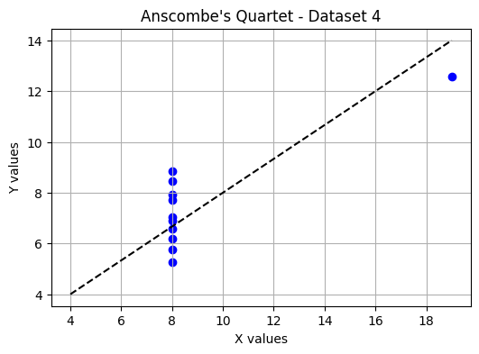
Anscombe’s Quartet
 | X | Y
 | 8.0 | 6.58
 | 8.0 | 5.76
 | 8.0 | 7.71
 | 8.0 | 8.84
 | 8.0 | 8.47
 | 8.0 | 7.04
 | 8.0 | 5.25
 | 19.0 | 12.0
 | 8.0 | 7.91
 | 8.0 | 6.80
 | 8.0 | 6.17
Mean | 9.00 | 7.50
Std | 3.31662 | 1.86025
Correlation | 0.81628
Dataset 4: Most points are the same, but one extreme outlier changes the overall statistics.

Slide 57
Anscombe’s Quartet
 | X | Y
 | 10.0 | 8.04
 | 8.0 | 6.95
 | 13.0 | 7.58
 | 9.0 | 8.81
 | 11.0 | 8.33
 | 14.0 | 9.96
 | 6.0 | 7.24
 | 4.0 | 4.26
 | 12.0 | 10.84
 | 7.0 | 4.82
 | 5.0 | 5.68
Mean | 9.00 | 7.50
Std | 3.3166 | 2.030
Corr | 0.81628
 | X | Y
 | 10.0 | 9.14
 | 8.0 | 8.14
 | 13.0 | 8.74
 | 9.0 | 8.77
 | 11.0 | 9.26
 | 14.0 | 8.10
 | 6.0 | 6.13
 | 4.0 | 3.10
 | 12.0 | 9.13
 | 7.0 | 7.26
 | 5.0 | 4.74
Mean | 9.00 | 7.50
Std | 3.31662 | 2.0304
Corr | 0.81628
 | X | Y
 | 10.0 | 7.46
 | 8.0 | 6.77
 | 13.0 | 12.74
 | 9.0 | 7.11
 | 11.0 | 7.81
 | 14.0 | 8.84
 | 6.0 | 6.08
 | 4.0 | 5.39
 | 12.0 | 8.15
 | 7.0 | 6.42
 | 5.0 | 5.73
Mean | 9.00 | 7.50
Std | 3.31662 | 2.0304
Corr | 0.81628
 | X | Y
 | 8.0 | 6.58
 | 8.0 | 5.76
 | 8.0 | 7.71
 | 8.0 | 8.84
 | 8.0 | 8.47
 | 8.0 | 7.04
 | 8.0 | 5.25
 | 19.0 | 12.0
 | 8.0 | 7.91
 | 8.0 | 6.80
 | 8.0 | 6.17
Mean | 9.00 | 7.50
Std | 3.31662 | 1.8602
Corr | 0.81628

Slide 58
Anscombe’s Quartet

Slide 59
Anscombe’s Quartet
Why This is Important:
Although all four datasets have similar statistical summaries, their actual patterns are completely different when visualized.
Imagine analyzing students’ test scores. The average score might be 75, but without visualization, you wouldn’t know if most students scored around 75 or if half failed and half excelled.
Statistics alone cannot give us the full picture. Visualizing data helps us:
✔ Identify real trends.
✔ Detect outliers and unusual patterns.
✔ Avoid misleading conclusions.
By plotting data, researcher see the true story hidden behind numbers.

Slide 60
Types of Graph/Chart/Plot

Slide 61
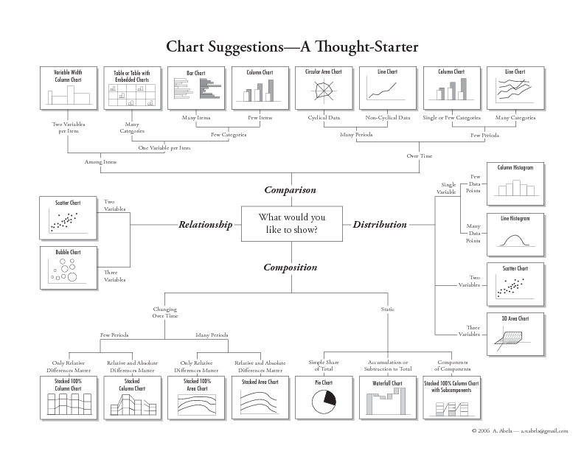
Types of Graph/Chart/Plot

Slide 62
1. Dot Plot
A dot plot is a simple and effective way to visualize data by representing individual data points. It is beneficial when displaying numerical data and comparing values across categories or along a continuous function.
Dot plots show only the data points without connecting them with lines.
In mathematical terms, if a function y = f(x), a dot plot displays the points (x, y) as separate markers on a graph, while a line plot links them with lines to form a continuous representation of the function.

Slide 63
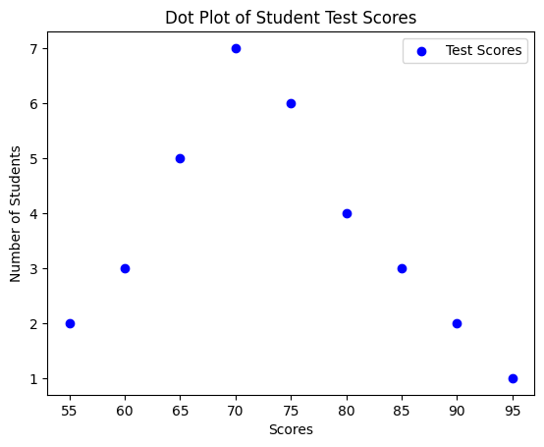
1. Dot Plot
When to Use Dot Plots
Comparing small datasets (Easier to read than a bar chart for small values).
Showing frequency distributions (Useful for identifying clusters and gaps).
Emphasizing individual data points (Ensures no data is hidden within lines or bars).

Slide 64
2. Line Chart
Line charts are widely used in data visualization to show trends over time or relationships between two numerical variables.
Creating effective line charts requires following some best practices:
Show Actual Data, Not Just the Fitted Line
Show the Full Range of Data
Use Color to Differentiate Multiple variables

Slide 65
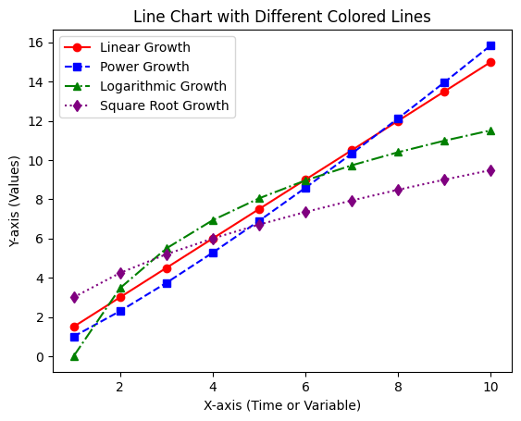
2. Line Chart
Usage: Shows trends over time or continuous data with connected data points.
Best for: Time-series analysis, stock price trends, and temperature changes.

Slide 66
3. Scatter Plot
When working with large datasets, visualizing thousands of points in a plot can be challenging. If not done correctly, the data points overlap and create a black ball of death—a dense, unreadable spot of points.
However, Scatter plots, when properly designed, can effectively represent thousands of data points in a clear and understandable way.
A properly drawn scatter plot helps in:
✔ Detecting trends (e.g., does weight increase with height?)
✔ Identifying outliers (unusual points that don’t follow the trend)
✔ Observing clusters (groups of similar data points)

Slide 67
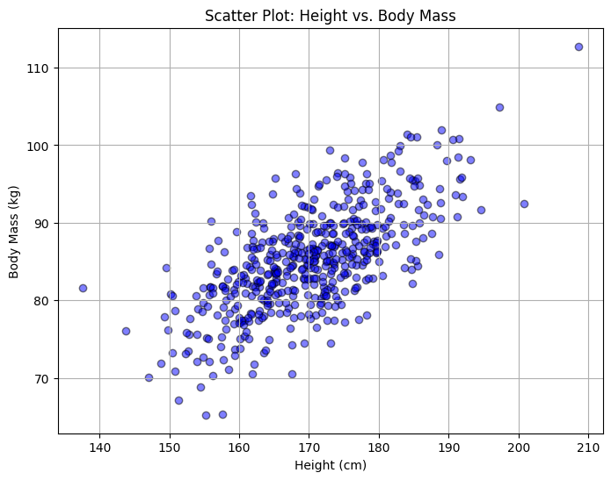
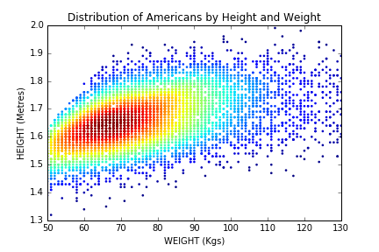
3. Scatter Plot
Usage: Shows relationships between two numerical variables by plotting points.
Best for: Detecting correlations, identifying clusters, and spotting outliers.

Slide 68
4. Bubble Chart
A bubble plot is a type of scatter plot where the size and color of each point represent additional information.
Instead of just showing two variables (X and Y), a bubble plot can display three or more dimensions by changing the size, color, and shading of each bubble.
This makes it easier to see patterns, trends, and relationships in complex data. For example, in a business dataset, a bubble plot can show sales revenue on the X-axis, profit on the Y-axis, and market size as the size of the bubble.

Slide 69
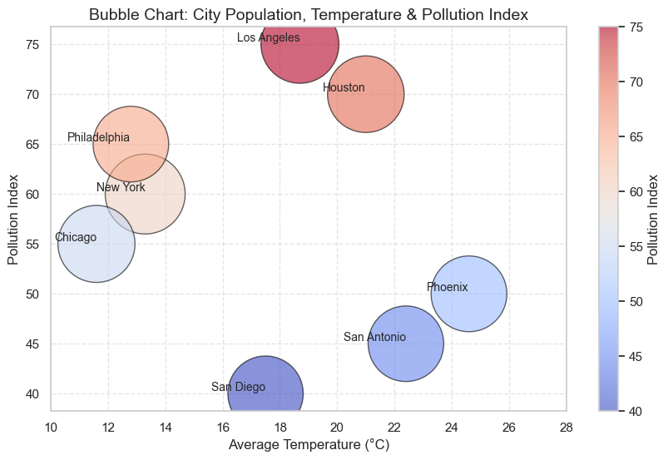
4. Bubble Chart

Slide 70
5. Bar Chart
A bar plot uses rectangular bars to represent different categories, where each bar’s height (or length) corresponds to the category’s frequency or proportion.
Precise comparisons: Since bars are aligned to a common baseline, it is easy to compare their sizes.
Trends and changes: Bar charts help visualize increasing or decreasing trends.
Grouped and stacked options: Can show multiple categories side by side or stacked to compare sub-groups.
Use Bar Charts when precise comparisons are needed, trends must be analyzed, or multiple subcategories exist.

Slide 71
6. Pie Chart
A pie chart divides a circle into slices, where each slice represents a percentage of the total. It is useful when showing how each category contributes to the whole.
Good for percentage-based data when you want to show a part-to-whole relationship.
Visually appealing and intuitive for showing distribution.
Hard to compare slices accurately, especially when the differences are small.
Not space-efficient and can be difficult to read when there are too many categories.
Labels can be confusing if they are placed far from the corresponding slices.

Slide 72
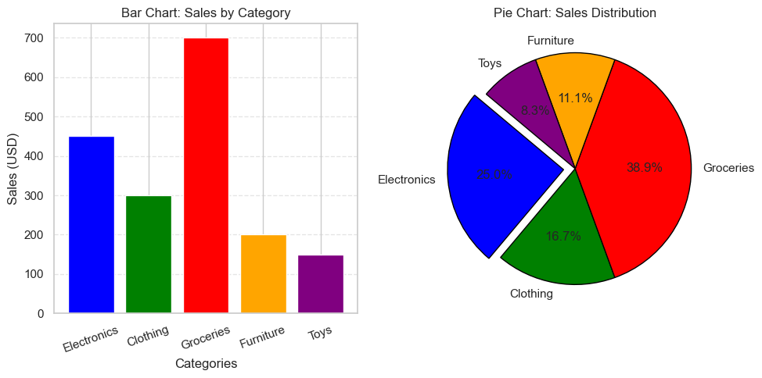
Bar Chart & Pie Chart

Slide 73
7. Box Plot (or Box-and-Whisker Plot)
A box plot (also known as a box-and-whisker plot) is a powerful visualization tool used to display the distribution, spread, and outliers of numerical data.

Slide 74
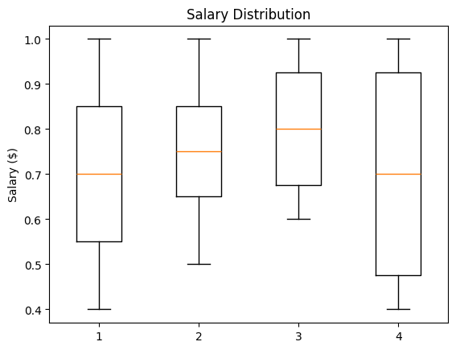
7. Box Plot (or Box-and-Whisker Plot)
Usage:
Comparing distributions across multiple categories.
Identifying skewness, spread, and outliers.
Understanding variability in datasets like exam scores, salaries, stock prices, and sensor readings.

Slide 75
8. Histogram
A histogram shows how data is distributed by grouping values into bins and counting how often they appear. It helps identify peaks, skewness, and extreme values.
Why does the bin’s value matter?
Too few bins hide details.
Too many bins add noise.
The right bin count depends on data size and what we want to see.
Histograms give a clear picture of frequency distribution, making patterns easy to understand.

Slide 76
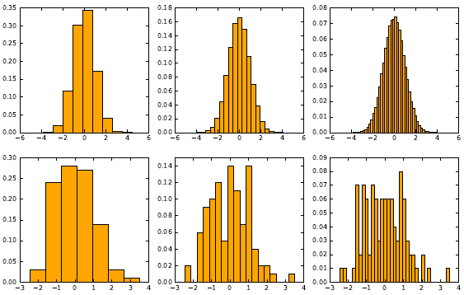
8. Histogram
Illustration of Bin value/size on datasets

Slide 77
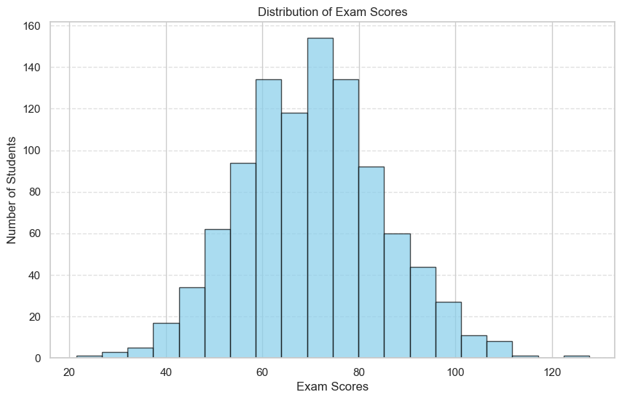
8. Histogram
Simulating 1,000 students’ scores using a normal distribution with a mean of 70 and a standard deviation of 15.

Slide 78
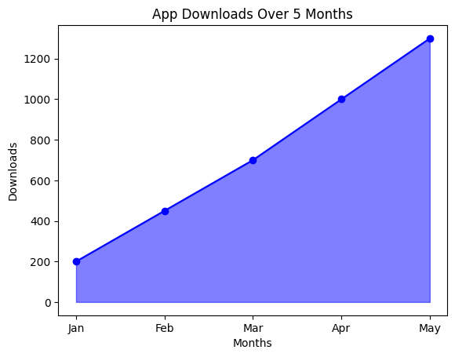
9. Area Chart
Usage: Similar to a line chart but with filled areas, representing cumulative data.
Best for: Showing trends and cumulative values.
Example: Monthly app downloads.

Slide 79
10. Data Map
Data maps use color or shading to highlight the properties of different regions on a map. Each region represents a place, concept, or category, making it visually clear how data is distributed.
In the 2012 U.S. Presidential Election, a map was used to show which states voted for Barack Obama (blue) and which states voted for Mitt Romney (red). This helped in understanding the political divide across different parts of the country. The north-east and west coasts were mostly blue, while the mid-west and south were largely red.

Slide 80
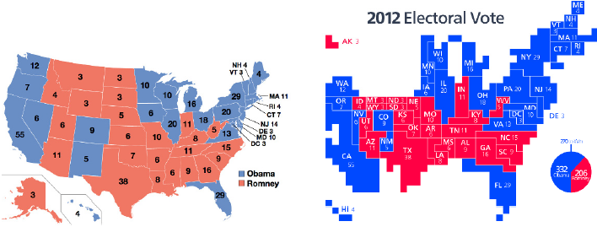
10. Data Map
Maps summarizing the results of the 2012 U.S. presidential election.

Slide 81

Not included in Syllabus
If you were taking a nap, wake up… the lecture is over!

Slide 82

Recap
Introduction to Datasets and Online Platforms:
Introduction to dataset,
Searching and Downloading datasets from different online platforms
Preprocessing
Exploratory Data Analysis (EDA)
Data Visualization

